Slide 1


RBFNN
Ha-Rang Kim
25.3.9
ⓒSaebyeol Yu. Saebyeol’s PowerPoint

Slide 2
Table of contents
1
Design of IFRBNN Based on IWFCM Clusterig and Weighted LSE Estimation
2
A Study on the Design of RBFNN Applied with the Aid of a Novel Learning Method: Focused on Improvement of Performance of Prediction Model and Pattern Classifier

Slide 3
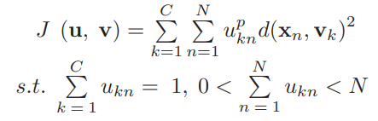
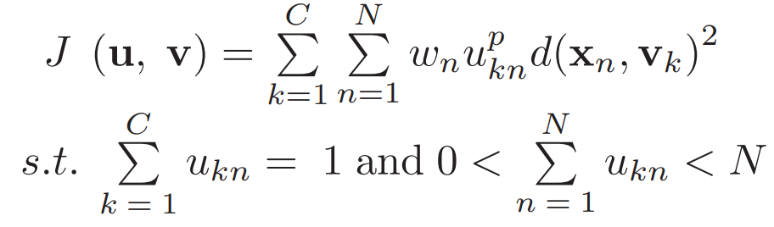
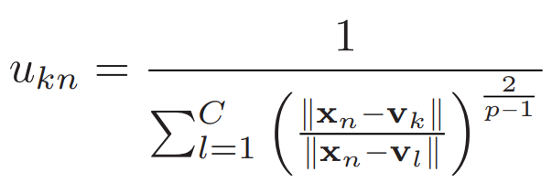
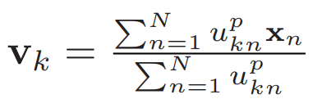
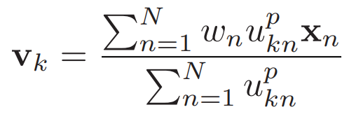


IFRBFNN
<FCM>
<WFCM>
Cross-entropy

Slide 4
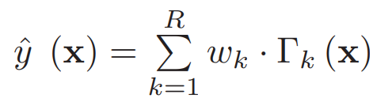
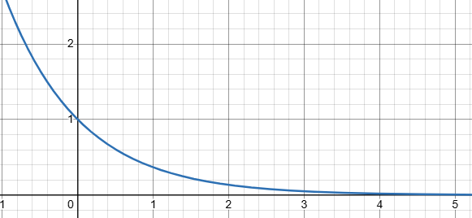
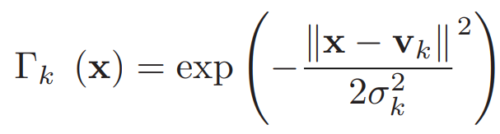

IFRBFNN
<Generic RBFNN>
Global optimal approximation
Classification capabilities
Rapid convergence
$$e^{−x}$$

Slide 5
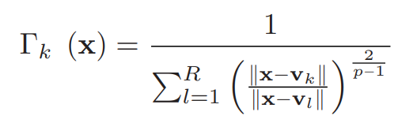
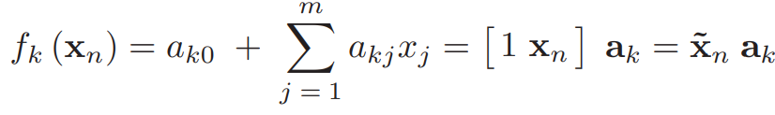
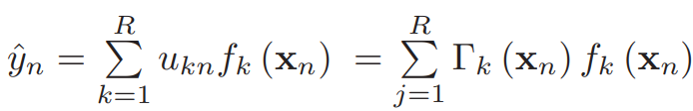
IFRBFNN
<Enhanced RBFNN>
Activation level
Connection weight

Slide 6


IFRBFNN
<WLSE(weighted least square error)>
<LSE>
<WLSE>
Equal importance
for each data point
Learning
with weighted data

Slide 7
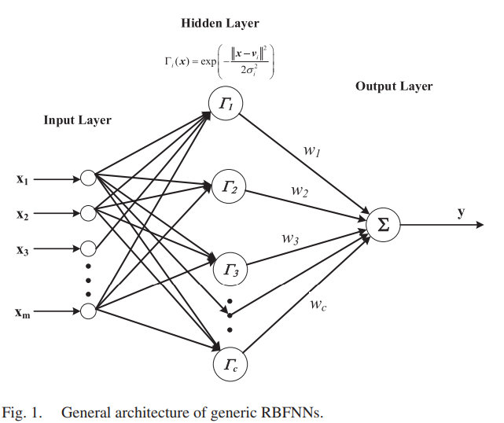
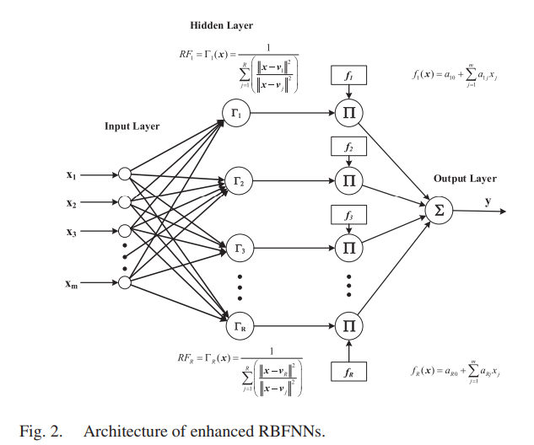





IFRBFNN
<Generic RBFNN>
<Enhanced RBFNN>

Slide 8
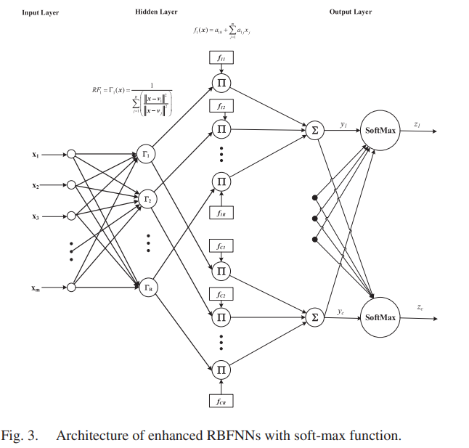

IFRBFNN
<Soft max>

Slide 9


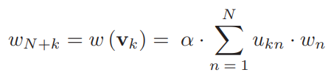
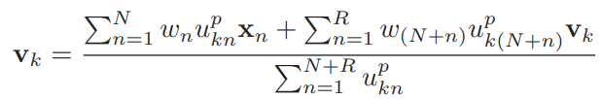




IFRBFNN
<Cross-entropy loss(auxiliary information)>
<WFCM>
Misclassified -> Higher weight

Slide 10




IFRBFNN
<Cross-entropy>
<WLSE>
Spatial information
Misclassified -> Higher weight

Slide 11




IFRBFNN
<Stopping Refinement Criterion>
Predicted class(soft max)
Different -> 1
Same -> 0 -> stop

Slide 12
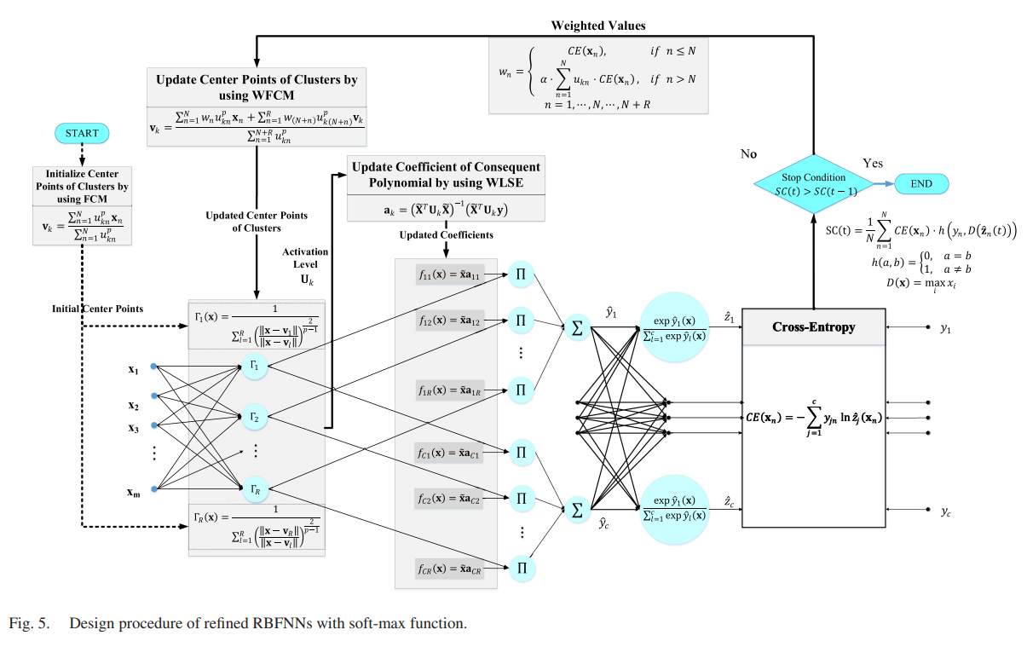
IFRBFNN

Slide 13
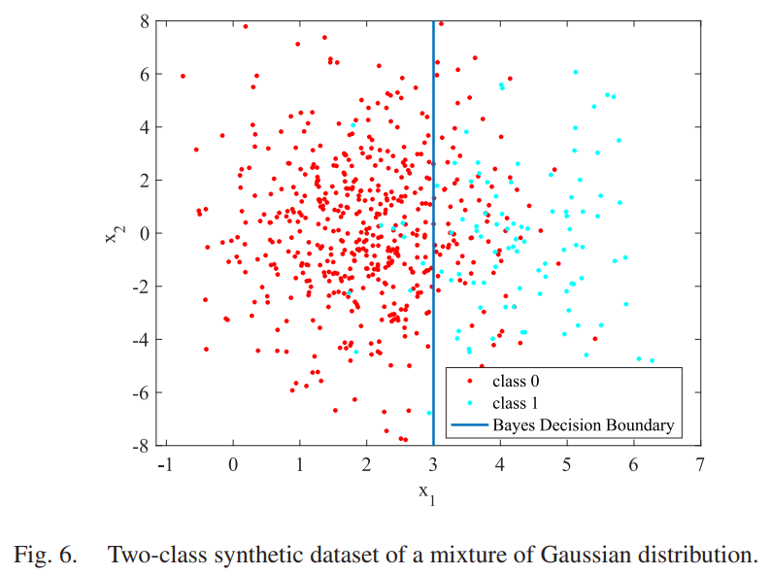
IFRBFNN

Slide 14
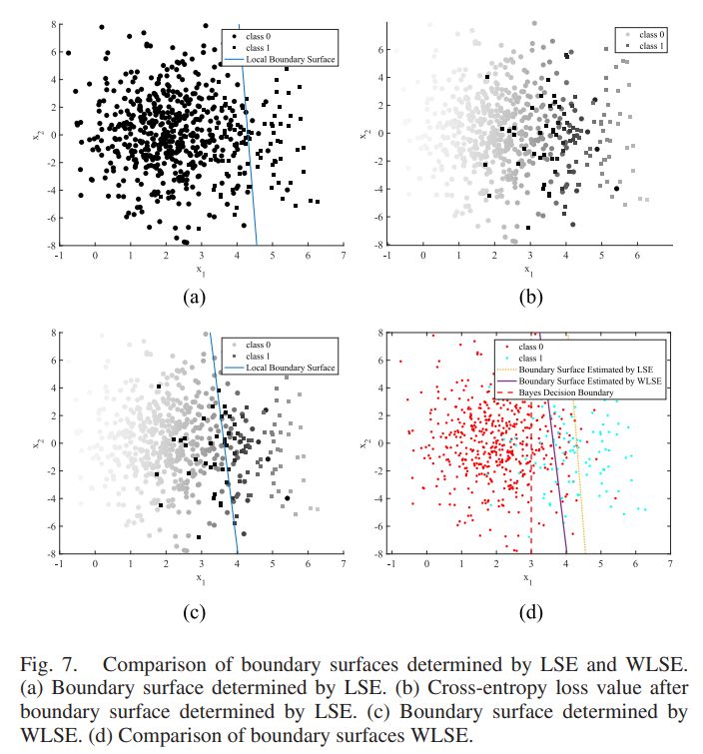
IFRBFNN

Slide 15
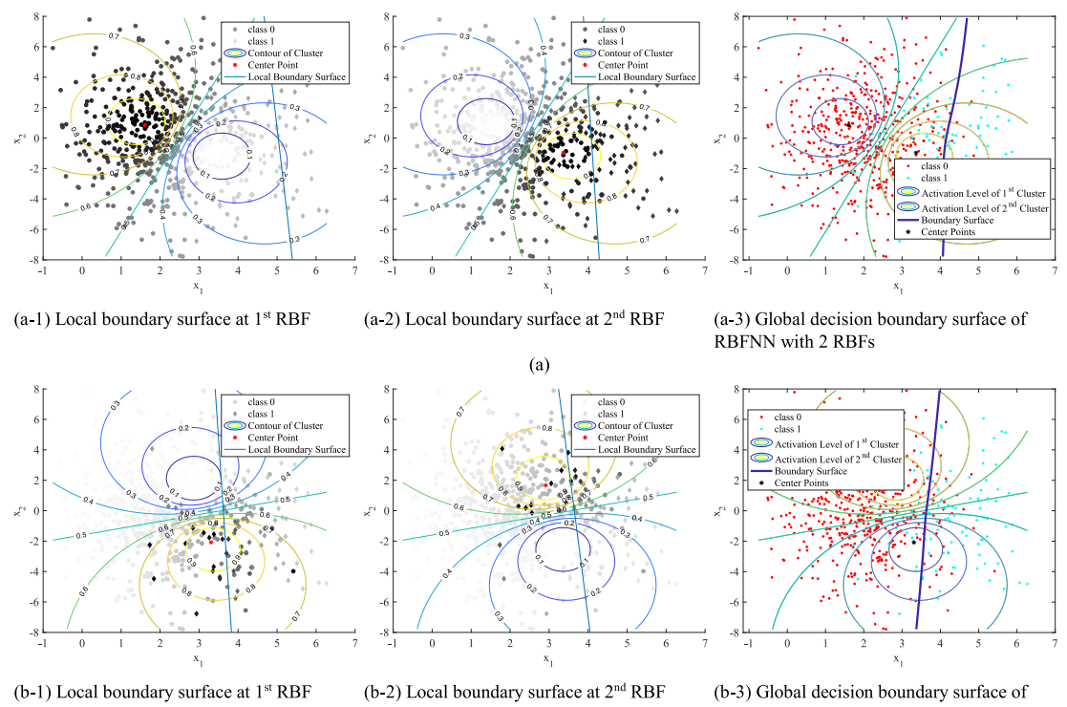
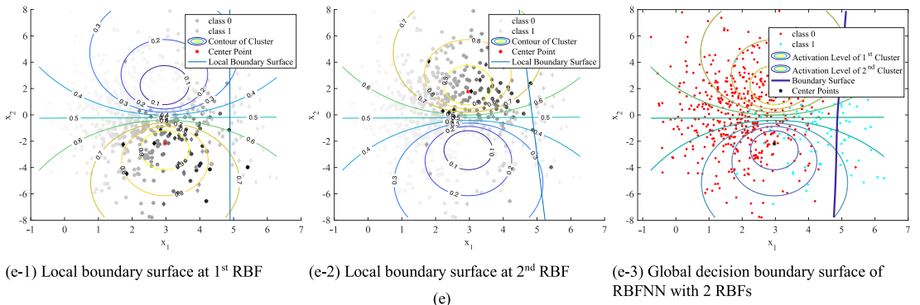
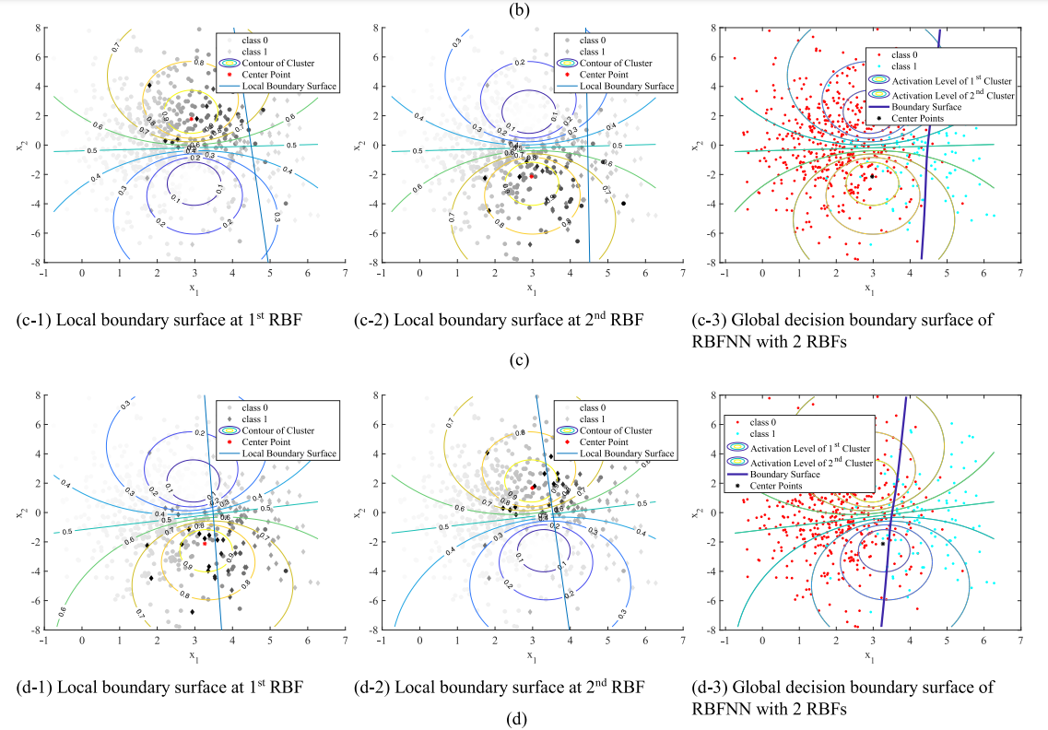
IFRBFNN

Slide 16
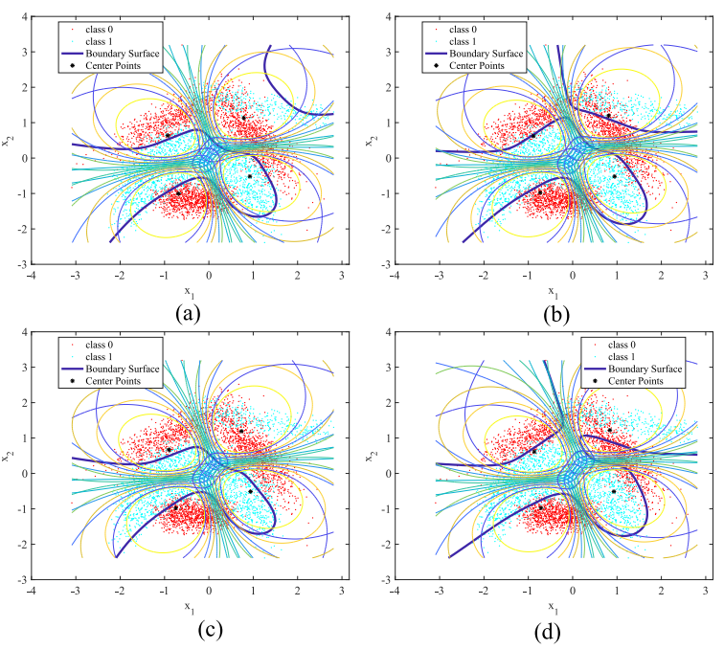
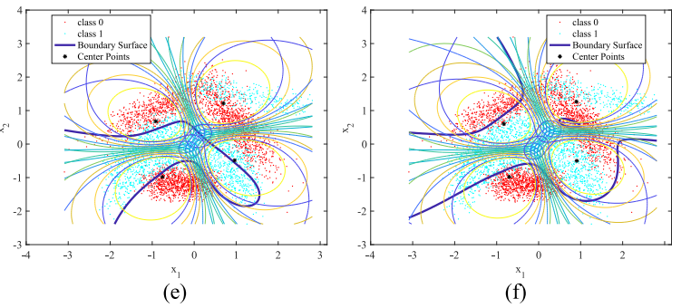
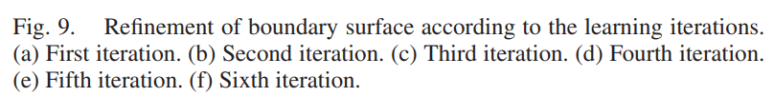
IFRBFNN

Slide 17
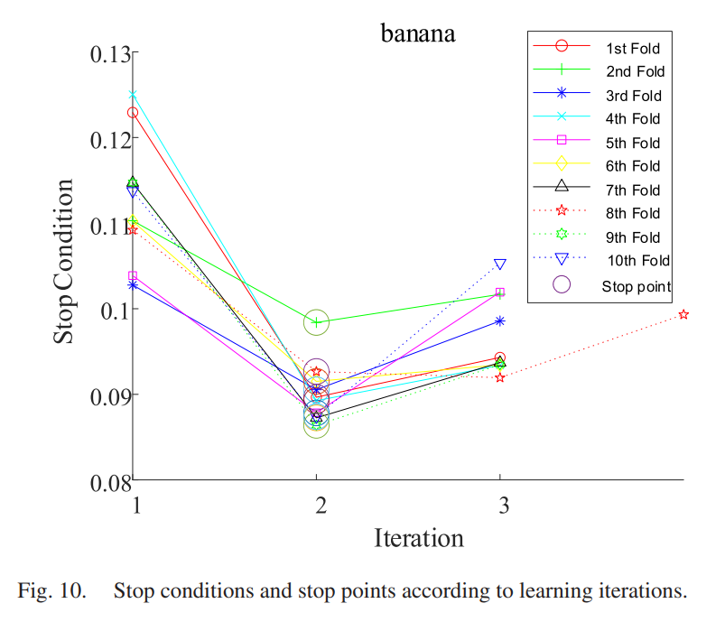
IFRBFNN

Slide 18
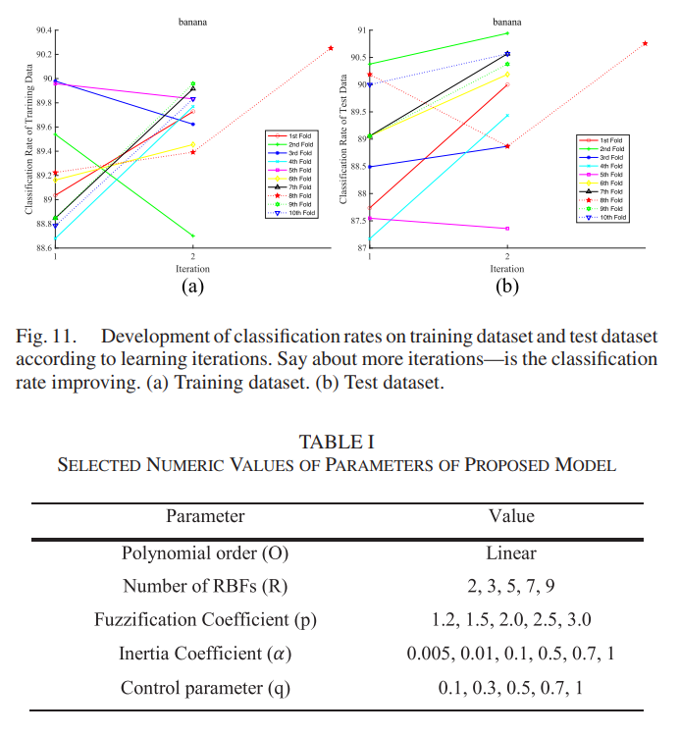
IFRBFNN

